Slide 1
Office of Analytics
Update Concerning the Status of COVID-19 in Nevada
Kyra Morgan, MS, State Biostatistician

Slide 2
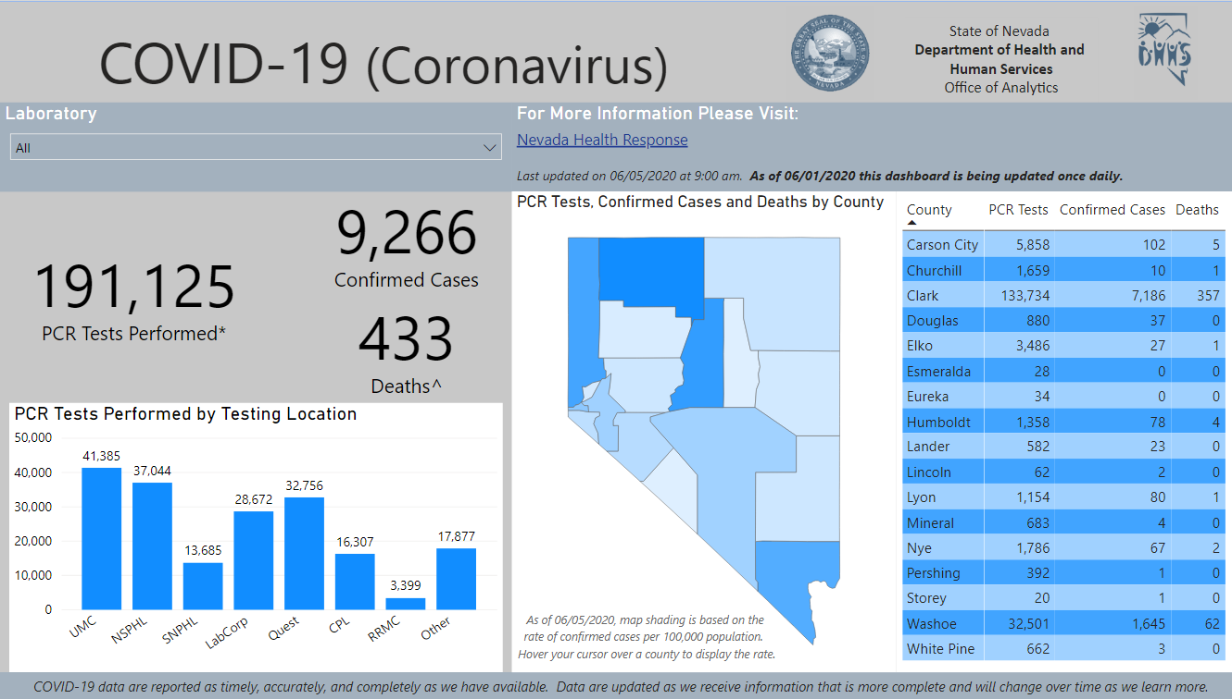
COVID-19 Status Update:
nvhealthresponse.nv.gov
As of 6/4/2020 –
191,125 PCR COVID-19 tests have been reported to DHHS (166,002 unique people tested)
9,266 COVID-19 cases have been confirmed through PCR testing
433 Nevadan’s have died from COVID-19

Slide 3
COVID-19 Status Update:
As of 6/4/2020 –
Clark County has the most confirmed cases and deaths, followed by Washoe County
Humboldt County has the highest rate per 100,000 population, followed by Lander, Washoe, and Clark counties

Slide 4
COVID-19 Status Update:
For the most recent week, on average –
126 new cases daily. This represents a growth rate of 1.5%
3 new deaths daily. This represents a growth rate of <1%

Slide 5
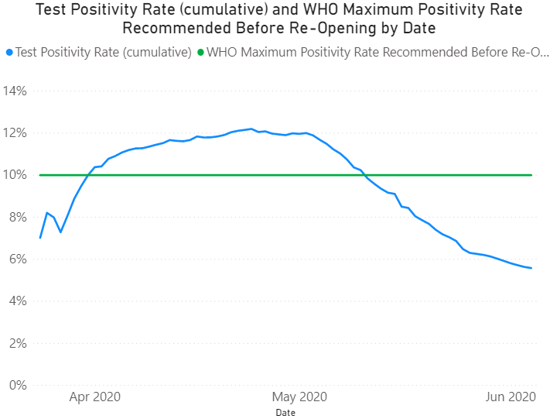
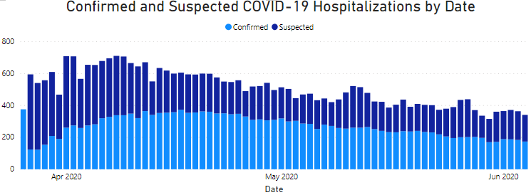
COVID-19 Status Update:
The test positivity rate has been following a downward trend since 4/25/2020.
Confirmed COVID-19 hospitalizations have been following a downward trend since 4/21/2020.

Slide 6
COVID-19 Demographics
Age
Sex
Race/Ethnicity
Nevada’s
Population:
Confirmed
Cases:
Deaths:
Hispanic Nevada residents are testing positive disproportionately.
Black Nevada residents are testing positive and dying disproportionately.
Asian Nevada residents, male Nevada residents, and older Nevadans aged 60+ are dying disproportionately.

Slide 7
COVID-19 in Facilities
As of 6/4/2020:
1,290 confirmed COVID cases associated with facilities (14% of total cases)
750 residents
540 staff
1,122 (12% of total cases) in long term care facilities
compared to ~11% nationally
120 COVID deaths associated with facilities (28% of total deaths)
116 residents
4 staff
92 (21% of total deaths) in long term care facilities
compared to 30-45% nationally

Slide 8
Facility Releases
From the start of the COVID-19 pandemic in Nevada, until the initial phase of closures and stay-at-home orders (3/1/2020 – 3/12/2020) –
189 individuals were released from State prisons
87 youth were released from foster care group homes
11 youth were released from State juvenile justice facilities

Slide 9
Summary
Minority populations and older adults (60+) in Nevada are disproportionately affected by COVID-19.
Eleven percent (12%) of Nevada’s COVID cases and 21% of deaths are associated with skilled nursing facilities, compared to 11% and 30-45% nationally.
There are fewer cases, hospitalizations, and deaths than were predicted by many of the models early in the outbreak. This means that social distancing and restrictions worked.
Models continue to indicate a high likelihood that Nevada reached a peak in the number of new cases reported daily and has since declined.
We have seen slight increases in daily new cases since around mid May. This is likely due primarily to increased testing.
A rise in cases is likely to occur as restrictions are lifted.
We have not seen an effect on COVID hospitalizations or test positivity rate yet.
Nevada has built the infrastructure required for the health care and public health systems to be able to adequately respond by providing appropriate levels of care and containing the spread of the virus.

Slide 10
Questions?

Slide 11
Contact Information
Kyra Morgan
State Biostatistician
kmorgan@health.nv.gov
Please direct questions to data@dhhs.nv.gov

Slide 12
Acronyms
PCR - Polymerase Chain Reaction
WHO – World Health Organization

