Slide 1
Division of Health Care Financing and Policy
Nevada Medicaid and Comparative Reimbursement Rates Across States
Suzanne Bierman, Administrator
November 30, 2020

Slide 2
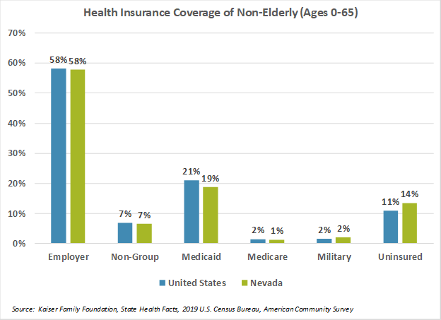
Source of Insurance Coverage in Nevada

Slide 3
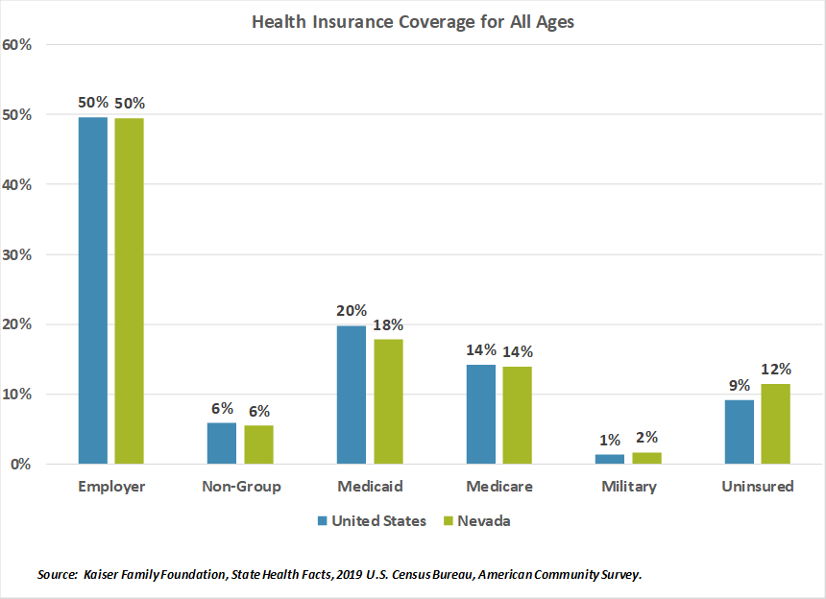
Source of Insurance Coverage in Nevada

Slide 4
Nevada Medicaid Rate Overview
As of October 2020, Nevada Medicaid has 38,290 enrolled providers across 64 provider types and numerous specialties.
Nevada Medicaid has over 290,000 active reimbursement rates.
Fee-for-service rate development methodologies include:
Fee Schedule-based – set using relevant Medicare Fee Schedules and adjustment factors such Relative Value Units and location adjustments.
Cost-based – set using cost factors such as paid wages and time studies.
Prospective Payment System Rates – flat rates for a service, encounter, or time period. May be based on cost report data.
Negotiated Rates – provider specific rates for out-of-state providers or specialized care.

Slide 5
Overview of Rate Analysis and Development
The Rate Analysis and Development (RAD) Unit is responsible for rate development, rate studies/reviews, rate appeals, Medicaid Rate Policies and scheduled rate updates. RAD is also responsible for the fiscal impact analyses associated with these processes.
Rates Policy is located in the Medicaid Services Manual, Chapter 700: MSM 700 PDF
Methods and standards used to determine rates for Nevada Medicaid are located in the Nevada State Plan under Section 4.19 – Payment for Services: Nevada State Plan - 4.19 PDF
Changes to rate methodologies require a State Plan Amendment (SPA). Workshops and public hearings are held prior to submitting a SPA to CMS allowing providers and stakeholders the opportunity to provide public comment. The proposed changes are sent to the Centers for Medicare and Medicaid Services (CMS) for review and approval.

Slide 6
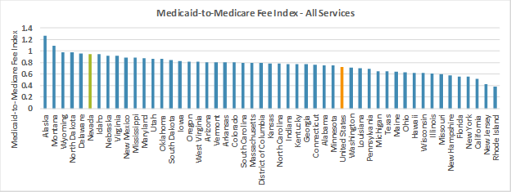
Rate Comparison by Payors (Medicare – Medicaid)
According to the latest national data available from the Kaiser Family Foundation’s Medicaid-to-Medicare Fee Index, Nevada’s reimbursement rates were ranked 6th highest in the nation for All Services, 6th for Primary Care, and 13th for Obstetric Care. Calculations based this index indicate that Nevada’s rates for All Services exceeded the national average by 32%, Primary Care by 44%, and Obstetric Services by 20%.

Slide 7
Legislative Studies - AB108 and 116
Assembly Bill 108 that passed in the 2017 legislative session mandates review by DHCFP of all rates every four years.
As of January 2019, there are over 290,000 active rates for Nevada Medicaid, covering 64 provider types. (A provider type indicates what kind of provider is doing the billing. Provider types may include individuals, facilities, or other organizational structures.)
The rate review process is organized by Provider Type. The schedule of reviews is posted here: Quad. Yr. Review Schedule.xlsx (nv.gov)

Slide 8
Legislative Studies- AB108 and 116
AB 116:
Legislation was proposed (but did not pass) in 2019 that would have required DHCFP to conduct an actuarial study to determine the cost to the State of revising certain reimbursement rates .
DHCFP conducted preliminary analyses in response to a legislative request related to this bill in 2018.
DHCFP estimated that aligning certain Medicaid rates with 2018 Medicare rates would have required an additional $174 million over the biennium in general fund appropriations to align to Medicare rates.
This was likely understated as many provider types and managed care organizations were not included in the preliminary analyses.
Several in-depth actuarial analyses would be needed to fully develop a more complete understanding of the fiscal impact of aligning Medicaid and Medicare rates.
Memo available here: https://www.leg.state.nv.us/Session/80th2019/Exhibits/Assembly/HHS/AHHS317F.pdf

Slide 9
Questions?

